Slide 1

COMS W4111 - Introduction to Databases
DBMS Architecture and Implementation: Query Processing, Transactions, Recovery
Donald F. Ferguson (dff@cs.columbia.edu)
Lecture 11: Query Processing, Transactions, Recovery, V2

Slide 2

Contents
2 | Introduction to Databases (F18): Lecture 11 Query Processing. Transactions, Recovery

Slide 3
Contents
Roadmap for the remainder of the course/semester:
Topics
Homework
Final Exam
Completing query processing and query optimization:
Reminder: Overview and Concepts
Some Examples
Homework 3
Transactions: Concepts, Implementation, Examples
Availability and Recovery: Concepts, ARIES Algorithm

Slide 4
Semester Roadmap
4 | Introduction to Databases (F18): Lecture 11 Query Processing. Transactions, Recovery

Slide 5
Modules – Reminder
Module I: Foundational Concepts
1. Introduction to databases, role in applications, type of DB applications and overall system software architecture.
2. Information and data modeling and best practices, focusing on supporting application scenarios.
3. Relational data model (theory), Relational Database Management Systems, Structured Query Language, data query and update scenarios.
4. Extended topics in SQL and RDBMS (performance, security, constraints, triggers, connection management, etc).
Module II: Database Management System Implementation/Architecture
5. Storage management, disk management, buffer management, indexes.
6. Query processing and optimization: Query evaluation, query parsing and parse trees, operator implementation algorithms, query rewrite, query optimization techniques.
7. Concurrency control and transaction management.
Module III: NoSQL Database Overview
8. Overview, graph databases, Redis.
9. Amazon S3, Amazon DynamoDB, Google Firebase/Cloud Firestore.
Module IV: Decision Support, Data Analysis
10. Overview of schema denormalization, OLAP cubes, data analytics, machine learning.

Slide 6
Planned Schedule -- Lectures
Lectures
09-Nov:
Complete query optimization
Transactions
Availability, Recovery
16-Nov: NoSQL Databases
Neo4J – Graph database
Redis – Key/Value, data structure store
Amazon S3 – Blob storage
Amazon DynamoDB – Partitioned, JSON
30-Nov: Big Data/Decision Support
Hadoop/Mapreduce
OLAP, Pivot Tables
De-normalization
Machine Learning
07-Dec: Overflow, Final exam discussion
Exams/Assignments
HW3:
Published: 05-Nov
Due: 18-Nov
HW4:
Publication: 16-Nov
Due: 30-Nov
HW5:
Publication: 30-Nov
Due: 10-Dec
Final Exam:
Publication: 07-Dec
Due: 16-Dec

Slide 7
Planned Schedule -- Lectures
Lectures
09-Nov:
Complete query optimization
Transactions
Availability, Recovery
16-Nov: NoSQL Databases
Neo4J – Graph database
Redis – Key/Value, data structure store
Amazon S3 – Blob storage
Amazon DynamoDB – Partitioned, JSON
30-Nov: Big Data/Decision Support
Hadoop/Mapreduce
OLAP, Pivot Tables
De-normalization
Machine Learning
07-Dec: Overflow, Final exam discussion
Exams/Assignments
HW3:
Published: 05-Nov
Due: 18-Nov
HW4:
Publication: 16-Nov
Due: 30-Nov
HW5:
Publication: 30-Nov
Due: 10-Dec
Final Exam:
Publication: 07-Dec
Due: 16-Dec
I am away 09-Nov – 14-Nov
I want to make sure I can have enough OH/recitation near due date.
Should be significantly easier and shorter than HW 1, 2 or 3.
But, …clearly, I am a bad judge of “easy.” I will try.
I want you to get some exposure and be able to put on resume’.

Slide 8
Module II – Reminder
8 | Introduction to Databases (F18): Lecture 11 Query Processing. Transactions, Recovery

Slide 9
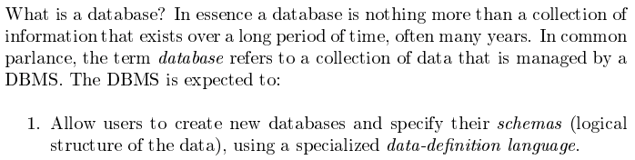
Database Management System Reminder
Covered for the relational model.
Database Systems: The Complete Book (2nd Edition) by Hector Garcia-Molina (Author), Jeffrey D. Ullman (Author), Jennifer Widom (Author)
9 | Introduction to Databases (F18): Lecture 10: Query Processing, Transactions, Recovert © Donald F. Ferguson, 2018

Slide 10
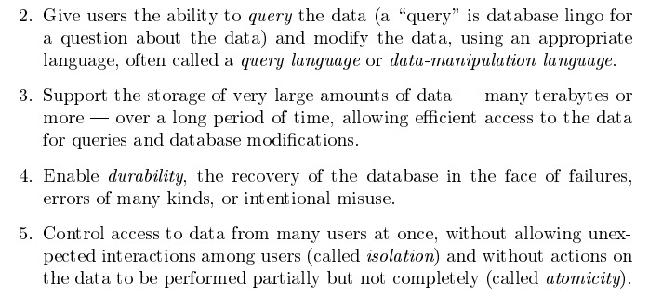
Database Management System Reminder
Focus of current part of course.
Database Systems: The Complete Book (2nd Edition) by Hector Garcia-Molina (Author), Jeffrey D. Ullman (Author), Jennifer Widom (Author)
10 | Introduction to Databases (F18): Lecture 10: Query Processing, Transactions, Recovert © Donald F. Ferguson, 2018

Slide 11

Data Management
Find things quickly.
Control access.
Durability
Database Systems: The Complete Book (2nd Edition) by Hector Garcia-Molina (Author), Jeffrey D. Ullman (Author), Jennifer Widom (Author)

Slide 12
Query Processing
12 | Introduction to Databases (F18): Lecture 11 Query Processing. Transactions, Recovery

Slide 13

Reminder
13 | Introduction to Databases (F18): Lecture 11 Query Processing. Transactions, Recovery

Slide 14
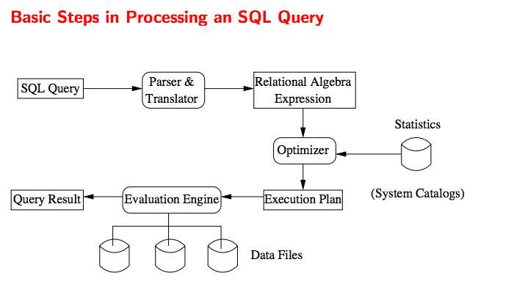
Query Processing Overview

Slide 15
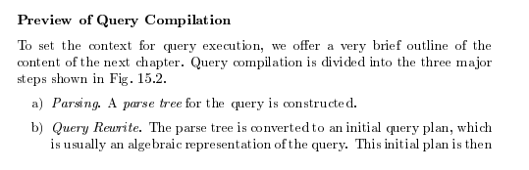
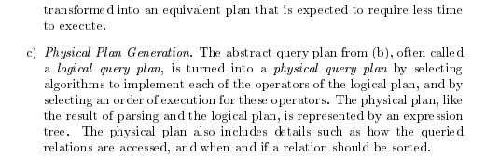
Query Compilation
Database Systems: The Complete Book (2nd Edition) 2nd Edition
by Hector Garcia-Molina (Author), Jeffrey D. Ullman (Author), Jennifer Widom (Author)
Previous
Lecture
Current
Lecture

Slide 16
Optimization/Execution
16 | Introduction to Databases (F18): Lecture 10 Query Processing. Transactions, Recovery

Slide 17
Overview of Query Evaluation
Plan: Tree of R.A. ops, with choice of alg for each op.
Each operator typically implemented using a `pull’ interface: when an operator is `pulled’ for the next output tuples, it `pulls’ on its inputs and computes them.
Two main issues in query optimization:
For a given query, what plans are considered?
Algorithm to search plan space for cheapest (estimated) plan.
How is the cost of a plan estimated?
Ideally: Want to find best plan. Practically: Avoid worst plans!
Notes:
2

Slide 18
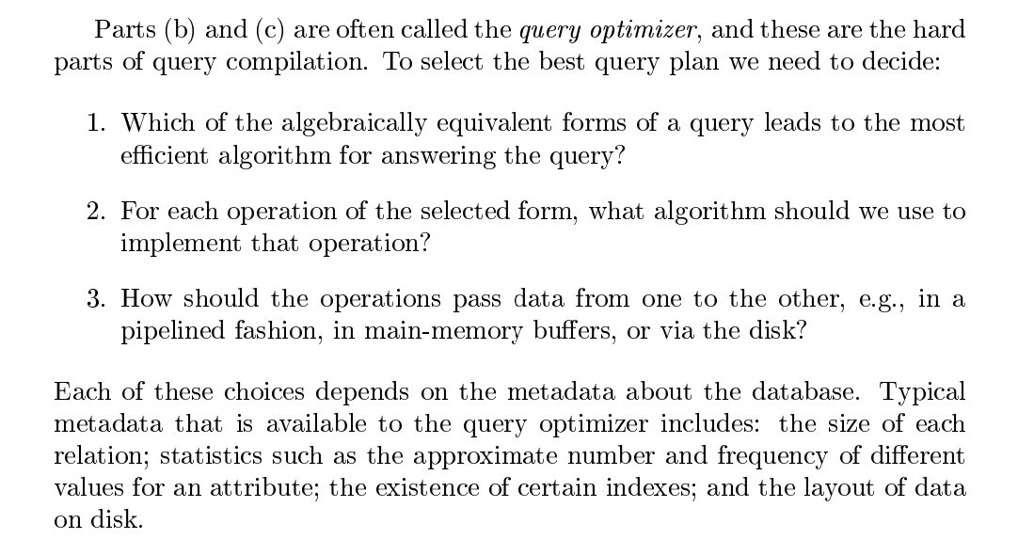
Query Optimization
Previous
Lecture

Slide 19
Homework 3 – “Diversion”
19 | Introduction to Databases (F18): Lecture 10 Query Processing. Transactions, Recovery

Slide 20
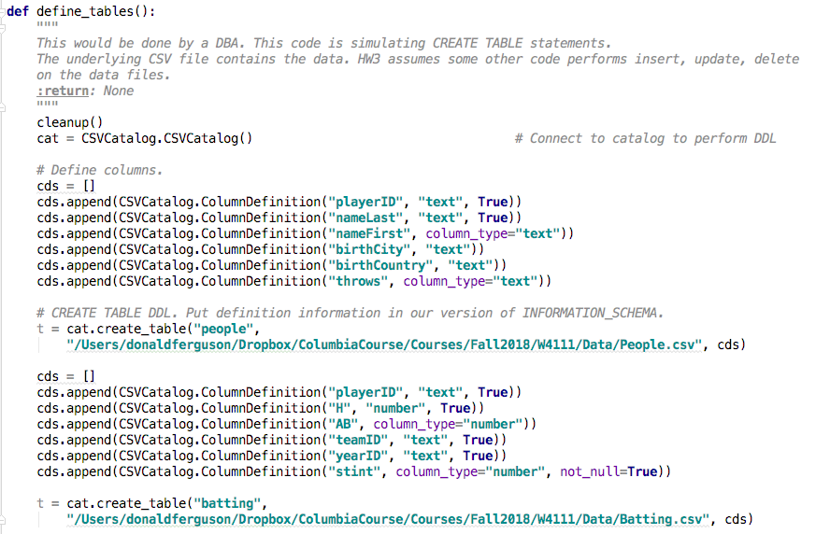
CREATE TABLE

Slide 21
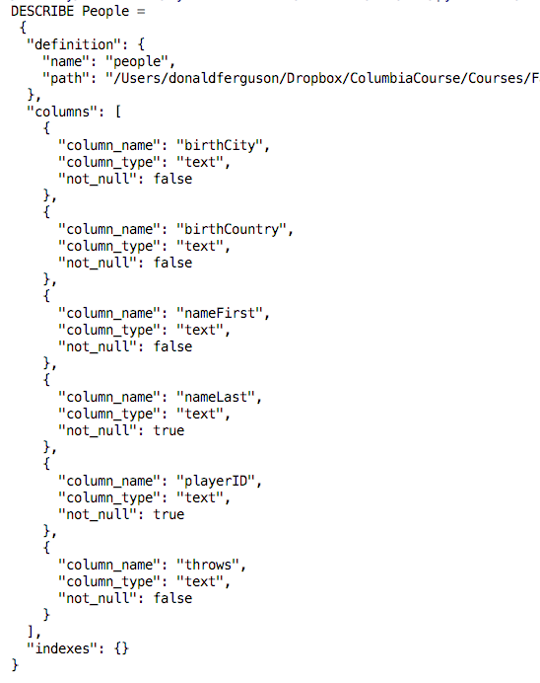
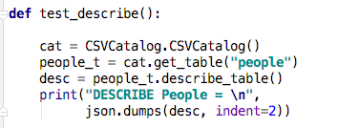
Describe Table

Slide 22
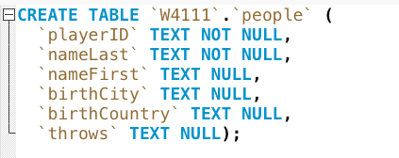
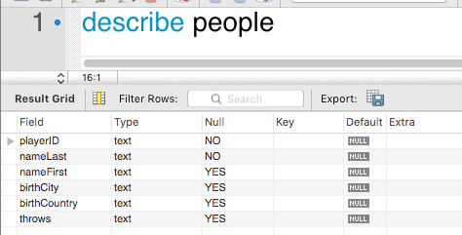
Analogy to RDB/MySQL
At some point, DBA defines tables
Later (much later), programmer can call DESCRIBE TABLE
The query processing engine will also use this information to
Validate statement correctness.
Perform optimizations.
For HW3, we are not worrying about insert, update, delete into the files.

Slide 23
MySQL Information Schema
You are doing something
Similar
Much simpler
For your CSVTables

Slide 24
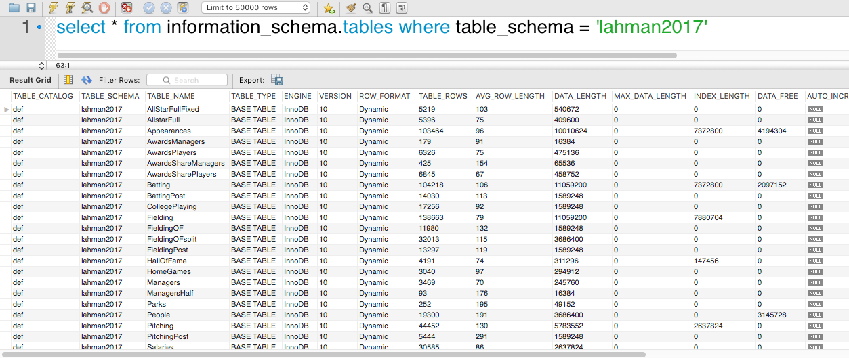
INFORMATION_SCHEMA.tables

Slide 25
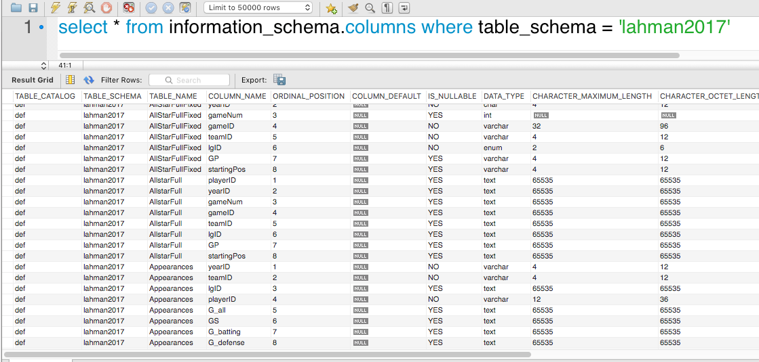
INFORMATION_SCHEMA.columns

Slide 26
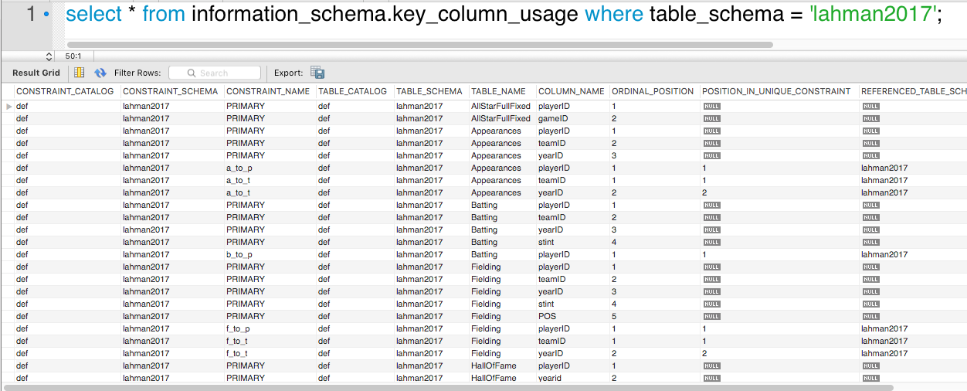
INFORMATION_SCHEMA.key_column_usage

Slide 27
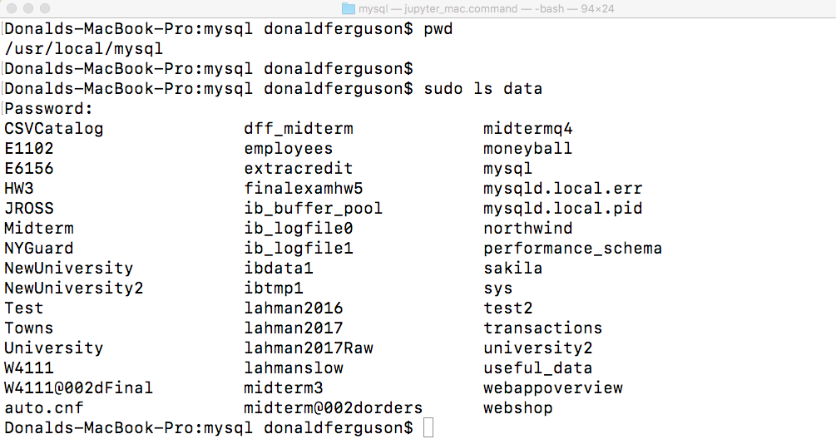
Where is the Data?

Slide 28
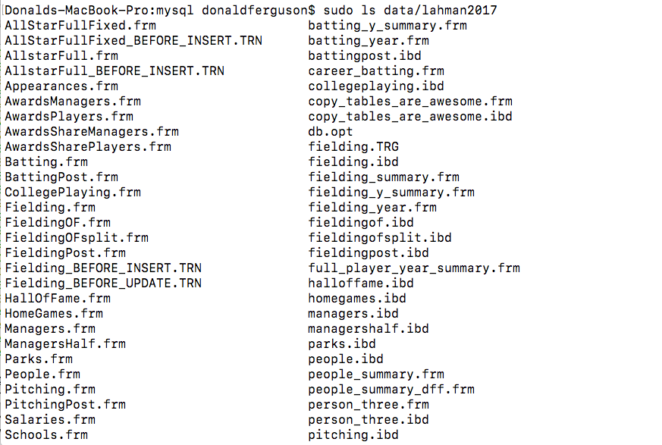
Where is the Data?
On my Mac
/usr/local/mysql/data
/usr/local/mysql/data/lahman2017
People.ibd
Batting.ibd
… …
For the CSVTables
../Data
People.csv
Batting.csv
… …

Slide 29
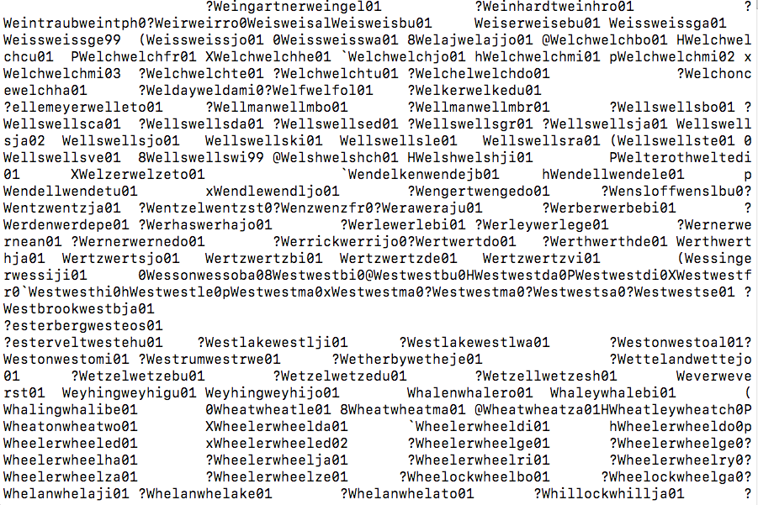
The .ibd File
“By default, all InnoDB tables and indexes are stored in the system tablespace. As an alternative, you can store each InnoDB table and associated indexes in its own datafile. This feature is called “file-per-table tablespaces” because each table has its own tablespace, and each tablespace has its own .ibd data file.”

Slide 30
The .ibd File
“By default, all InnoDB tables and indexes are stored in the system tablespace. As an alternative, you can store each InnoDB table and associated indexes in its own datafile. This feature is called “file-per-table tablespaces” because each table has its own tablespace, and each tablespace has its own .ibd data file.”
MySQL has several approaches to saving table data and index entries.
.idb/file per table stores uses one file for
Tuples
Index entries
Your solution uses
One file per table for data.
Builds/rebuilds the indexes in memory on load.

Slide 31
Query Optimization – Access Path
31 | Introduction to Databases (F18): Lecture 10 Query Processing. Transactions, Recovery

Slide 32
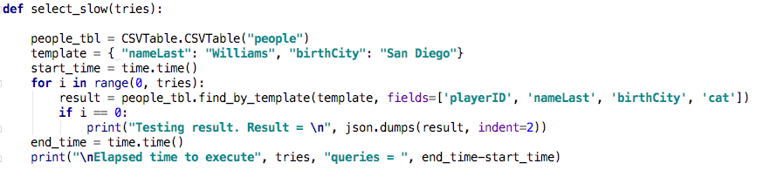
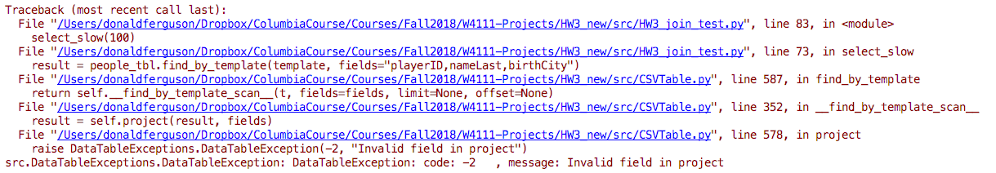
Simple “Select” Operation – HW 3
That is one purpose of the metadata.
The find_by_template() is syntactically correct, but references an invalid column.

Slide 33
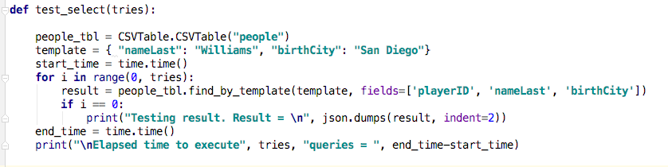
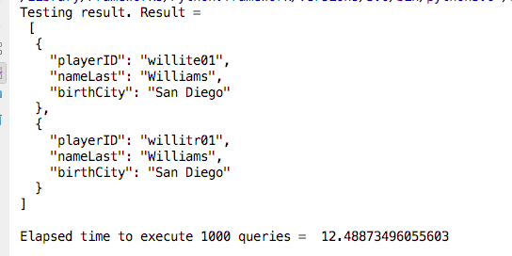
Baseline Performance

Slide 34
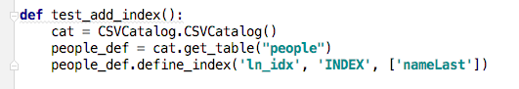
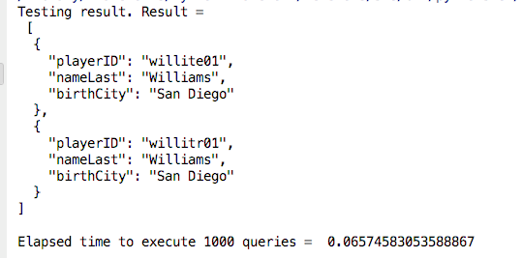
ALTER TABLE ADD INDEX
Adding a non-unique index on “nameLast”
Improves performance by three orders of magnitude.

Slide 35
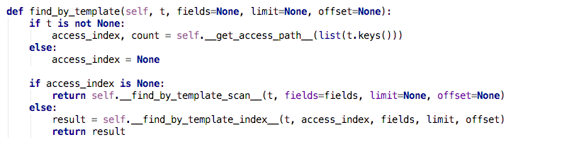
find_by_template()
Use the WHERE clause to find the “best” matching index.
If there is an index, use it.
If not, must scan the table.

Slide 36
Access Path
Every relational operator accepts one or more tables as input. The operator “accesses the tuples” in the tables.
There are two “ways” to retrieve the tuples
Scan the relation (via blocks)
Use an index and matching condition.
A selection (WHERE) condition is in conjuctive normal form if
Each term is column_name op value
op is one of <, <=, =, >, >=, <> (or =, != for Hash Index)
The terms are ANDed, e.g. (nameLast = ‘Ferguson’) AND (ab > 500)
CNF allows using a matching index for the access path.
The engine can select a matching index
A Hash Index on (c1,c2,c3) if the condition is c1=x AND c2=y AND c3=z.
A Tree Index if the condition is (can be ordered as)
c1 op value
c1 op x AND/OR c2 op y
… …
Many indexes may match, and the engine chooses the most selective match (number of tuples or blocks) that match.

Slide 37
Access Path
Every relational operator accepts one or more tables as input. The operator “accesses the tuples” in the tables.
There are two “ways” to retrieve the tuples
Scan the relation (via blocks)
Use an index and matching condition.
A selection (WHERE) condition is in conjuctive normal form if
Each term is column_name op value
op is one of <, <=, =, >, >=, <> (or =, != for Hash Index)
The terms are ANDed, e.g. (nameLast = ‘Ferguson’) AND (ab > 500)
CNF allows using a matching index for the access path.
The engine can select a matching index
A Hash Index on (c1,c2,c3) if the condition is c1=x AND c2=y AND c3=z.
A Tree Index if the condition is (can be ordered as)
c1 op value
c1 op x AND/OR c2 op y
… …
Many indexes may match, and the engine chooses the most selective match (number of tuples or blocks) that match.
If the condition is (nameLast = ‘Williams) AND ( birthCity = ‘San Diego’)
Use the index to find entries with nameLast ‘Williams’
Scan the (smaller) result to find tuples with birthCity=‘San Diego’
If the condition is (nameLast = ‘Williams) OR ( birthCity = ‘San Diego’)
The index does not help.
I could use to find “Williams”
But need to scan anyway for ‘birthCity.’

Slide 38
Query Optimization – Overview
38 | Introduction to Databases (F18): Lecture 10 Query Processing. Transactions, Recovery

Slide 39
Three Core Optimization Techniques
Query rewrite: Transform the logical query into an equivalent, more efficient query (lower cost query), e.g.
R ⋈ S is the same as S ⋈ R
𝞼(R ⋈ S) is the same at 𝞼(R) ⋈ 𝞼(S)
𝛅(R ⋈ S) = 𝛅(R) ⋈ 𝛅(S), where 𝛅 is the distinct operator.
Access path selection: Which index to choose?
Operator implementation selection:
There are several related implementations for each operator
For example,
Sort Scan
Sort Join
Hash Join
Hash Distinct

Slide 40
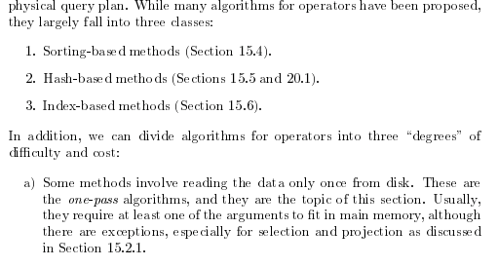
Query Optimization

Slide 41
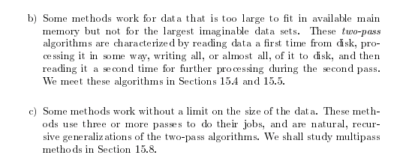
Query Optimization

Slide 42
Query Optimization – Query Rewrite and Algorithm Selection
42 | Introduction to Databases (F18): Lecture 10 Query Processing. Transactions, Recovery

Slide 43
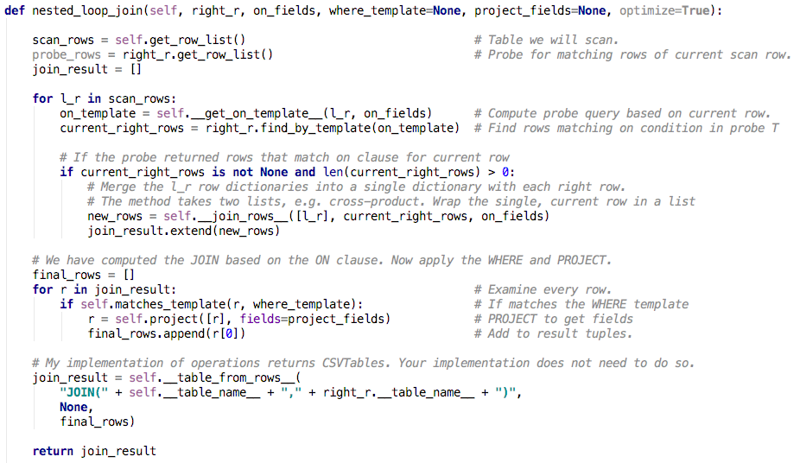
Cannonical Example – SELECT Pushdown
Baseline:
Nested Loop Join

Slide 44
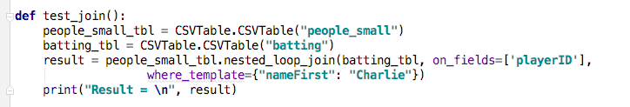
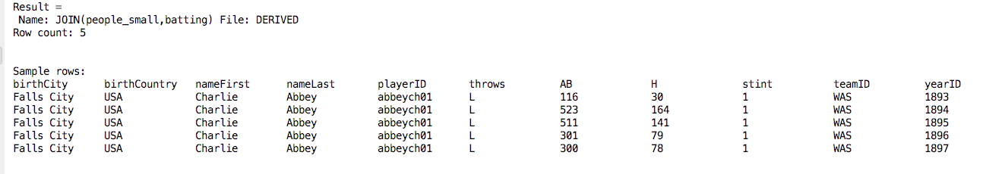
Cannonical Example – SELECT Pushdown
Executed on full People.csv
Requires 1,808 seconds.
Compares each of 19K rows with each of 104K rows = 2 billion.

Slide 45
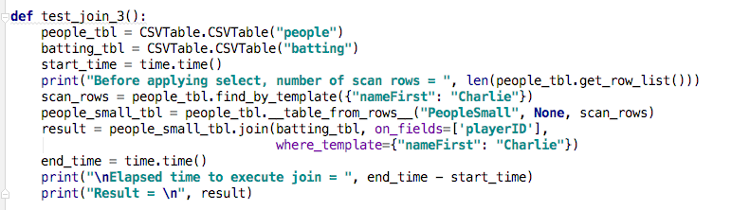
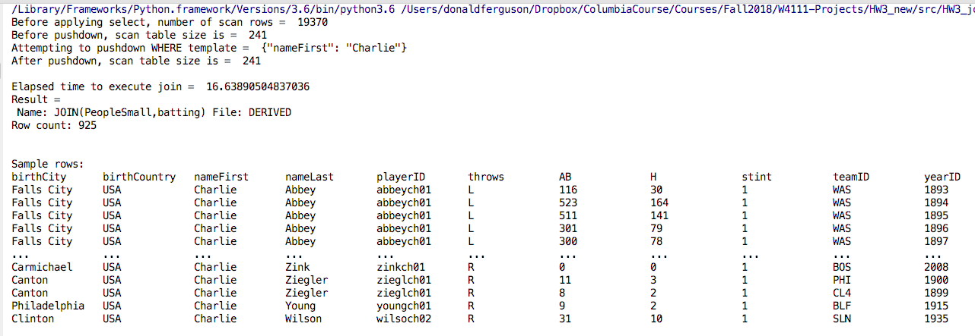
Cannonical Example – SELECT Pushdown

Slide 46
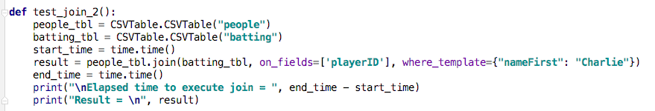
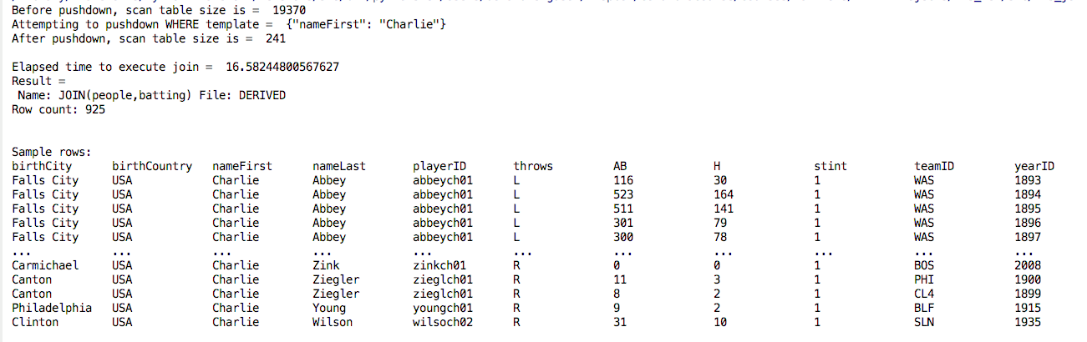
Cannonical Example – SELECT Pushdown
The JOIN detects that pushdown is possible
Does automatically

Slide 47
Cannonical Example – SELECT Pushdown
The basic rule: 𝞼(R ⋈ S) = 𝞼(R) ⋈ 𝞼(S)
There are several ways this rewrite can help:
Complexity goes from #(R) * #(S) to #(𝞼(R)) * #(𝞼(S)) [Note: #(X) is no. of tuples in X]
I/O (let B(X) be the number of disk blocks for X):
I scan R either way, which means I read EVERY disk block one time, B(R)
If I can allocate N buffer frames to the probe table, the probability of a cache hit goes from N/[#(S)] to N/[#(𝞼(S))], and I may be able to hold the entire 𝞼(S) in memory.
The JOINed table is derived, and does not have indexes. The engine may be able to use indexes for 𝞼(R) and 𝞼(S) The basic rule: 𝞼(R ⋈ S) = 𝞼(R) ⋈ 𝞼(S)
The rule π(R ⋈ S) = π(R) ⋈ π(S) may have I/O benefits for probing S. The query execution can cache more of the tuples in buffer frames.
NOTE: This is an example of query rewrite and two-pass algorithms.

Slide 48
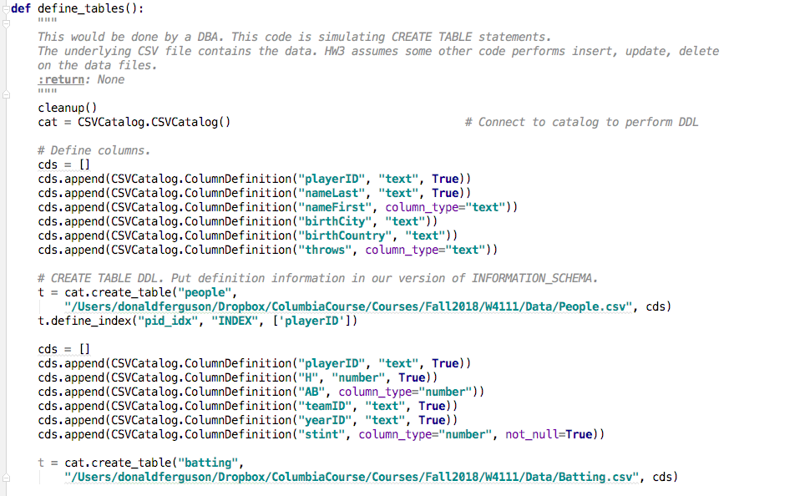
Swapping Probe and Scan Tables
This index does not help for R ⋈ S if the JOIN column is playerID.
I have to look at every row in R.
To form probe in S with the current row’s playerID.
But, R ⋈ S is the same as S ⋈ R
If I
Scan S to form the probe query into R on playerID,
I can probe via the index.

Slide 49
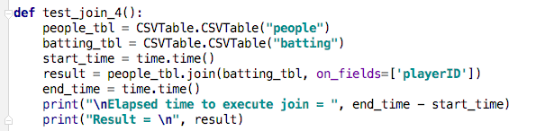
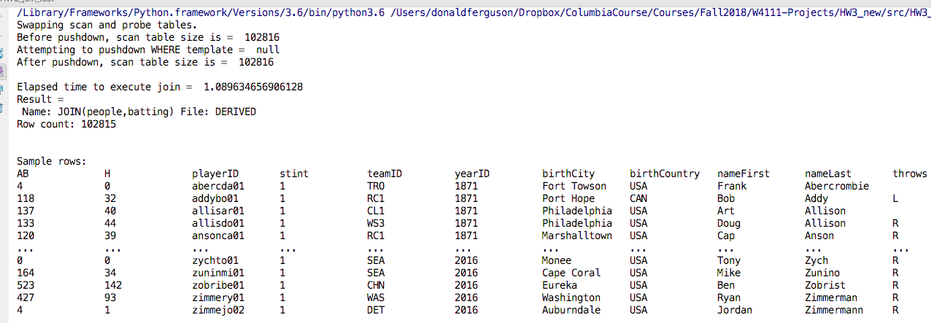
Swapping Probe and Scan Tables
The JOIN algorithm
Detects an index that applies to ON playerID
Swaps the scan and probe tables.
There is no WHERE clause to pushdown.
But,
I have a hash index on people.PlayerID
Query cost goes
From #(R) * #(S)
To #(S) * c, where c is a constant.
Would be #(S) * log[#(R)] for B+ Tree
Also not,
Because of the algorithm being a nested loop,
The row order changed in the result.

Slide 50
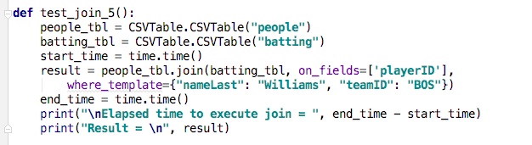
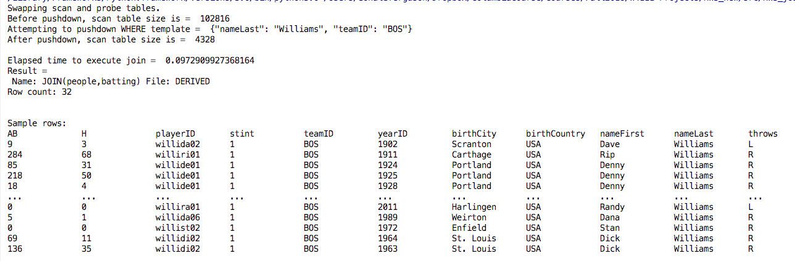
Putting the Pieces Together
Detects index for ON clause and swaps scan and probe tables.
Pushes down WHERE clause onto scan table.

Slide 51
Algorithm Selection
51 | Introduction to Databases (F18): Lecture 10 Query Processing. Transactions, Recovery

Slide 52
Hash JOIN
Consider SELECT * FROM people JOIN batting on people.playerID = batting.playerID
Assume:
People has 2 data blocks.
Batting has 2 data blocks.
I can allocate 3 buffer frames to the JOIN
One block holds the current block of R for the scan.
One holds a block of S.
One holds the JOIN result block I am current constructing.
For each row in R, the probability of a buffer hit is 1/2.
This means that I will do (1/2) * #(R) I/Os to probe S.
An alternate approach is to use a hash value on playerID to
Read R and partition into 2 buckets, each of size one block.
Read S and partition into 2 buckets, each of size one block.
I can process the join by loading the 1st block of the hashed R and 1st block of the hashed S into the buffer pool.
This means the S tuples matching the current playerID are in the buffer pool.
I do some extra upfront I/Os to read, partition and write the hashed tables.
But the nested loop is much, much more efficient.
We still have to scan the “probe” blocks when in memory, but we can hash again.

Slide 53
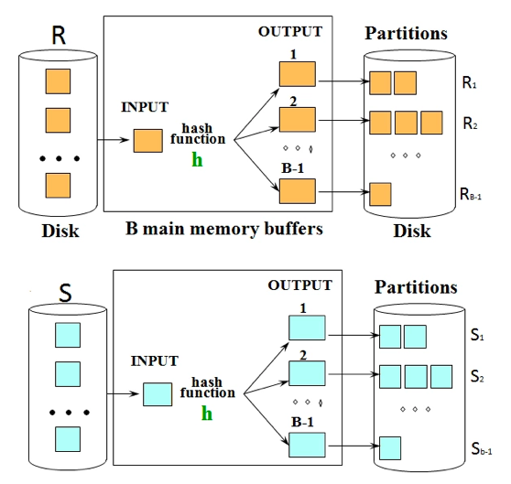
Hash JOIN (http://cs186.wikia.com/wiki/Joins)
Hash join uses two stages to accomplish the join.
The initial partitioning phase,
Followed by the probing phase.
In the first stage, we hash the two relations into partitions on disk using a hash function that partitions based on the join condition. The relation R gets partitioned into Ri and the relation S gets partitioned into Si. The diagram on the right demonstrates the first stage of the hash join. We will see that in the second stage, we will match Ri to Si partitions.

Slide 54
Hash JOIN (http://cs186.wikia.com/wiki/Joins)
In the second stage,
We use an in-memory hash table to perform the joining.
Read in partition Ri and hash it into the in memory hash table
Scan partition Si and probe the in memory hash table for matches.
Matches go to the output buffer

Slide 55
Summary
55 | Introduction to Databases (F18): Lecture 10 Query Processing. Transactions, Recovery

Slide 56
Summary
Query processing, execution and optimization:
Is very powerful.
Applies a large body of complex analytics and algorithms to optimize execution.
Allows developers to
Focus on declare the result they want using SQL.
Not worry about how to efficiently execute the computation.
Choosing the optimal plan for a query depends on
Table sizes.
Distribution of column values over ranges.
Index selectivity.
etc.
We have just touched the surface but need to move on …

Slide 57
Transactions
57 | Introduction to Databases (F18): Lecture 11 Query Processing. Transactions, Recovery

Slide 58
Core Transaction Concept is ACID Properties (http://slideplayer.com/slide/9307681)/)
ACID
Atomic
“ALL OR NOTHING”
Transaction cannot be subdivided
Consistent
Transaction → transforms database from one consistent state to another consistent state
Isolated
Transactions execute independently of one another
Database changes not revealed to users until after transaction has completed
Durable
Database changes are permanent
The permanence of the database’s consistent state

Slide 59
ACID Properties (httpwww.tutorialspoint.com/dbms/dbms_transaction.htm)
A transaction is a very small unit of a program and it may contain several low-level tasks. A transaction in a database system must maintain Atomicity, Consistency, Isolation, and Durability − commonly known as ACID properties − in order to ensure accuracy, completeness, and data integrity.
Atomicity − This property states that a transaction must be treated as an atomic unit, that is, either all of its operations are executed or none. There must be no state in a database where a transaction is left partially completed. States should be defined either before the execution of the transaction or after the execution/abortion/failure of the transaction.
Consistency − The database must remain in a consistent state after any transaction. No transaction should have any adverse effect on the data residing in the database. If the database was in a consistent state before the execution of a transaction, it must remain consistent after the execution of the transaction as well.
Durability − The database should be durable enough to hold all its latest updates even if the system fails or restarts. If a transaction updates a chunk of data in a database and commits, then the database will hold the modified data. If a transaction commits but the system fails before the data could be written on to the disk, then that data will be updated once the system springs back into action.
Isolation − In a database system where more than one transaction are being executed simultaneously and in parallel, the property of isolation states that all the transactions will be carried out and executed as if it is the only transaction in the system. No transaction will affect the existence of any other transaction.

Slide 60
Atomicity
60 | Introduction to Databases (F18): Lecture 10 Query Processing. Transactions, Recovery

Slide 61
Atomicity
A transaction is a logical unit of work that must be either entirely completed or entirely undone. (All writes happen or none of them happen)
OK. What does this mean? Consider some pseudo-code
def transfer(source_acct_id, target_acct_id, amount)
Check that both accounts exist.
IF is_checking_account(source_acct_id)
Check that (source_acct.balance-amount) > source_account.overdraft_limit
ELSE
Check that (source_count.balance-amount) >source_account.minimum_balance
Update source account
Update target account.
INSERT a record into transfer tracking table.

Slide 62
Atomicity
A transaction is a logical unit of work that must be either entirely completed or entirely undone. (All writes happen or none of them happen)
OK. What does this mean? Consider some pseudo-code
def transfer(source_acct_id, target_acct_id, amount)
Check that both accounts exist.
IF is_checking_account(source_acct_id)
Check that (source_acct.balance-amount) > source_account.overdraft_limit
ELSE
Check that (source_count.balance-amount) >source_account.minimum_balance
Update source account
Update target account.
INSERT a record into transfer tracking table.
Computer or DB Server fails.

Slide 63
Atomicty
Transaction programs and databases are fast (milliseconds). What are the chances of the failure occurring in the wrong spot?
Well, that doesn’t really matter. If it happens,
Someone lost money and
There is no record off it. Someone is going to very upset.
Even a small server can have thousands of concurrent transactions ➔
There will be corruptions because some transaction will be in the wrong place at the wrong time.
Unless we do something in the DBMS
Because HW and software inevitably fail
And sadly, SW is especially prone to failure when under load

Slide 64
Atomicity
OK. That stored procedure runs in milliseconds. What are the chances of the failure occurring there?
Well, that doesn’t really matter. If it happens,
Someone lost money and
There is no record off it. Someone is going to very upset.
Even a small server can have thousands of concurrent transactions ➔
There will be corruptions because some transaction will be in the wrong place at the wrong time.
Unless we do something in the DBMS
Because HW and software inevitably fail
And sadly, SW is especially prone to failure when under load

Slide 65
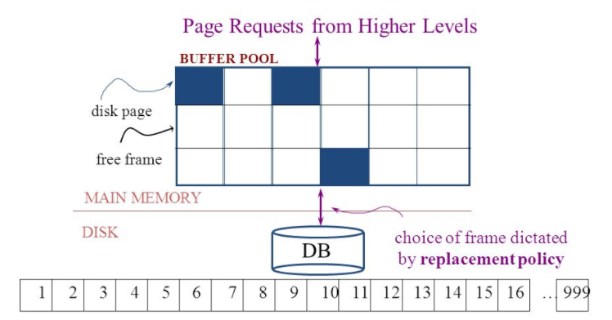
Simplistic Approach
Begin
Update A
Update B
Update C
Commit (REQ)
Force to disk
Commit (RSP)

Slide 66
Simplistic Approach
There are several problems with the simplistic approach.
The approach does not solve the problem
Some write might succeed.
Some might be interrupted by the failure, or require retry.
Writes may be random and scattered. N updates might
Change a few bytes in N data frames
A few bytes in M index frames
Transaction rate becomes bottlenecked by write I/O rate, even though a relative small number of bytes change/transaction.
Written frames must be held in memory.
Lots of transactions
Randomly writing small pieces of lots of frames.
Consumes lots of memory with pinned pages.
Degrades the performance and optimization of the buffer.
The optimal buffer replacement policy wants to hold frames that will be reused.
Not frames that have been touched and never reused.

Slide 67
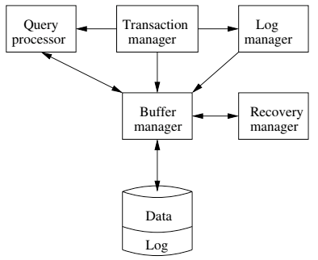
DBMS ACID Implementation
Implementation Subsystems
Query processor schedules and executes queries.
Buffer manager controls reading/writing blocks/frames to/from disk.
Log manager journals/records events to disk (log), e.g.
Transaction start/commit/abort
Transaction update of a block and previous value of data.
Transaction manager coordinates query scheduling, buffer read/write and logging to ensure ACID.
Recovery manager processes log to ensure ACID even after transaction or system failures.
Log is a special type of block file used by the system to optimize performance and ensure ACID.
Garcia-Molina et al., p. 846

Slide 68
Logging
The DBMS logs every transaction event
Log Sequence Number (LSN): A unique ID for a log record.
Prev LSN: A link to their last log record.
Transaction ID number.
Type: Describes the type of database log record.
Update Log Record
PageID: A reference to the Page ID of the modified page.
Length and Offset: Length in bytes and offset of the page are usually included.
Before and After Images of records.
Compensation Log Record
Commit Record
Abort Record Checkpoint Record
Completion Record notes that all work has been done for this particular transaction.

Slide 69
Write Ahead Logging
DBMS (Redo processing)
Write log events from all transactions into a single log stream.
Multiple events per page
Forces (writes) log record on COMMIT/ABORT
Single block I/O records many updates
Versus multiple block I/Os, each recording a single change.
All of a transaction’s updates recorded in one I/O versus many.
If there is a failure
DBMS sequentially reads log.
Applies changes to modified pages that were not saved to disk.
Then resumes normal processing.
Begin
Update A
Update B
Update C
Commit (REQ)
Force to disk
Commit (RSP)
Log

Slide 70
Write Ahead Logging
Force every write to disk?
Poor response time.
But provides durability.
Steal buffer-pool frames from uncommitted transactions?
If not, poor performance/caching performance
If yes, how can we ensure atomicity? Uncommitted updates on disk
DBMS (Undo processing)
Enable steal policy to improve cache performance by
Avoiding lots of pinned pages
Unlikely to be reused soon.
Before stealing
Force log record to disk.
Update log entry has data record
Before image
After image
If there is a failure
DBMS sequentially reads log.
Undoes changes to
modified pages, uncommitted pages
That were saved to disk.
Then resumes normal processing.
No Steal
Steal
Force
Trivial
No Force
Desired

Slide 71
ARIES Algorithm = Algorithms for Recovery and Isolation Exploiting Semantics
ARIES recovery involves three passes
Analysis pass:
Determine which transactions to undo
Determine which pages were dirty (disk version not up to date) at time of
RedoLSN: LSN from which redo should start
Redo pass:
Repeats history, redoing all actions from RedoLSN (updated committed but not written changes to pages)
RecLSN and PageLSNs are used to avoid redoing actions already reflected on page
Undo pass:
Rolls back all incomplete transactions (with uncommitted pages written to disk).
Transactions whose abort was complete earlier are not undone

Slide 72
Durability
72 | Introduction to Databases (F18): Lecture 10 Query Processing. Transactions, Recovery

Slide 73
Durability
Write changes to disk trivially achieves durability.
DBMS engine uses write-ahead-logging to
Achieve durability
But with better performance through more efficient caching and I/O.
Well, disks fail. How is that durable.
RAID and other solutions.
Disk subsystems, including entire RAID device, fail →
Duplex writes
To independent disk subsystems.
Well, there are earthquakes, floods, etc.

Slide 74
Availability and Replication
There are two basic patterns
Active/Passive
All requests go to master during normal processing.
Updates are transactionally queued for processing at passive backup.
Failure of master
Routes subsequent requests to backup.
Backup must process and commit updates before accepting requests.
Active/Active
Both environments process requests.
Some form of distributed transaction commit required to synchronize updates on both copies.
Multi-system communication to guarantee consistency is the foundation for tradeoffs in CAP.
The system can be CAP if and only iff
There are never any partitions or system failures
Which is unrealistic in cloud/Internet systems.

Slide 75
Isolation
75 | Introduction to Databases (F18): Lecture 10 Query Processing. Transactions, Recovery

Slide 76
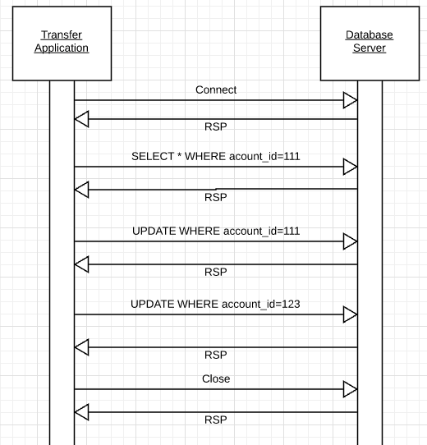
Isolation
Transfer $50 from
account_id=111 to
account_id=123
Requires 3 SQL statements
SELECT from 111 to check balance >= $50
UPDATE account_id=111
UPDATE account_id=123
There are some interesting scenarios
Two different programs read the balance ($51)
And decide removing $50 is OK.
DB constraints can prevent the conflict from happening, but …
There are more complex scenarios that constraints do not prevent.
Not ALL databases support constraints.
The “correct” execution should be that
One transaction responds “insufficient funds”
Before attempting transfer instead of after attempting.
Multiple readers

Slide 77
Isolation
Consider two simultaneous transfer transactions T1 and T2.
There are two equally correct executions
T1 transfers, T2 responds “insufficient funds” and does not attempt transfer
T2 transfers, T1 responds “insufficient funds” and does not attempt transfer
Each correct simultaneous execution is equivalent to a serial (sequential) execution schedule
(1) Execute T1, Execute T2
(2) Execute T2, Execute T1
NOTE:
We are focusing on correctness not
Fairness:
We do not care which transaction was actually submitted first.
And probably do not know due to networking, etc.
Transfer $50 from
account_id=111 to
account_id=123
Requires 3 SQL statements
SELECT from 111 to check balance >= $50
UPDATE account_id=111
UPDATE account_id=123
There are some interesting scenarios
Two different programs read the balance ($51)
And decide removing $50 is OK.
DB constraints can prevent the conflict from happening, but …
There are more complex scenarios that constraints do not prevent.
Not ALL databases support constraints.
The “correct” execution should be that
One transaction responds “insufficient funds”
Before attempting transfer instead of after attempting.
Multiple readers

Slide 78
Serializability
“In concurrency control of databases,^{[1][2]} transaction processing (transaction management), and various transactional applications (e.g., transactional memory^{[3]} and software transactional memory), both centralized and distributed, a transaction schedule is serializable if its outcome (e.g., the resulting database state) is equal to the outcome of its transactions executed serially, i.e. without overlapping in time. Transactions are normally executed concurrently (they overlap), since this is the most efficient way. Serializability is the major correctness criterion for concurrent transactions' executions. It is considered the highest level of isolation between transactions, and plays an essential role in concurrency control. As such it is supported in all general purpose database systems.” (https://en.wikipedia.org/wiki/Serializability)

Slide 79
DBMS ACID Implementation
Implementation Subsystems
Query processor schedules and executes queries.
Buffer manager controls reading/writing blocks/frames to/from disk.
Log manager journals/records events to disk (log), e.g.
Transaction start/commit/abort
Transaction update of a block and previous value of data.
Transaction manager coordinates query scheduling, buffer read/write and logging to ensure ACID.
Recovery manager processes log to ensure ACID even after transaction or system failures.
Log is a special type of block file used by the system to optimize performance and ensure ACID.
Garcia-Molina et al., p. 846

Slide 80
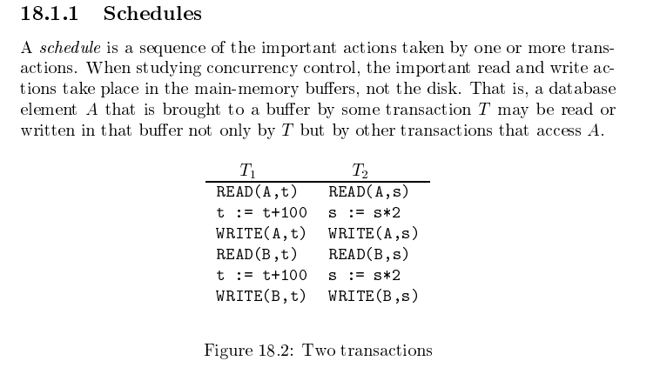
Schedule
Garcia-Molina et al.

Slide 81
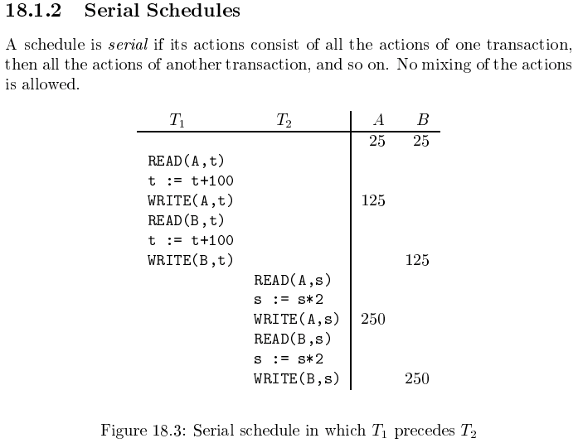
Serializable
Assume there are three
concurrently executing transactions
T1, T2 and T3
The transaction manager
Enables concurrent execution
But schedules individual operations
To ensure that the final DB state
Is equivalent to one of the following schedules
T1, T2, T3
T1, T3, T2
T2, T1, T3
T2, T3, T1
T3, T1, T2
T3, T2, T1
Concurrent execution was serializable.

Slide 82
Serializability (en.wikipedia.org/wiki/Serializability)
Serializability is used to keep the data in the data item in a consistent state. Serializability is a property of a transaction schedule (history). It relates to the isolation property of a database transaction.
Serializability of a schedule means equivalence (in the outcome, the database state, data values) to a serial schedule (i.e., sequential with no transaction overlap in time) with the same transactions. It is the major criterion for the correctness of concurrent transactions' schedule, and thus supported in all general purpose database systems.
The rationale behind serializability is the following:
If each transaction is correct by itself, i.e., meets certain integrity conditions,
then a schedule that comprises any serial execution of these transactions is correct (its transactions still meet their conditions):
"Serial" means that transactions do not overlap in time and cannot interfere with each other, i.e, complete isolation between each other exists.
Any order of the transactions is legitimate, (…)
As a result, a schedule that comprises any execution (not necessarily serial) that is equivalent (in its outcome) to any serial execution of these transactions, is correct.

Slide 83
Lock-Based Concurrency Control
Strict Two-phase Locking (Strict 2PL) Protocol:
Each Xact must obtain a S (shared) lock on object before reading, and an X (exclusive) lock on object before writing.
All locks held by a transaction are released when the transaction completes
(Non-strict) 2PL Variant: Release locks anytime, but cannot acquire locks after releasing any lock.
If an Xact holds an X lock on an object, no other Xact can get a lock (S or X) on that object.
Strict 2PL allows only serializable schedules.
Additionally, it simplifies transaction aborts
(Non-strict) 2PL also allows only serializable schedules, but involves more complex abort processing

Slide 84
Aborting a Transaction
If a transaction Ti is aborted, all its actions have to be undone. Not only that, if Tj reads an object last written by Ti, Tj must be aborted as well!
Most systems avoid such cascading aborts by releasing a transaction’s locks only at commit time.
If Ti writes an object, Tj can read this only after Ti commits.
In order to undo the actions of an aborted transaction, the DBMS maintains a log in which every write is recorded. This mechanism is also used to recover from system crashes: all active Xacts at the time of the crash are aborted when the system comes back up.

Slide 85
Locking
Transaction Manager
Intercepts all database operations.
Acquires/checks locks on
Records
Pages
Index pages
Suspends and queues an operation
In another active, executing op.
Has a conflicting lock.
Restarts queued operations when conflicting locks are released.
Garcia-Molina et al., p. 846

Slide 86
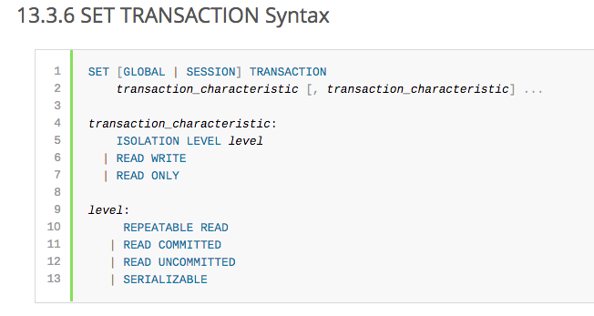
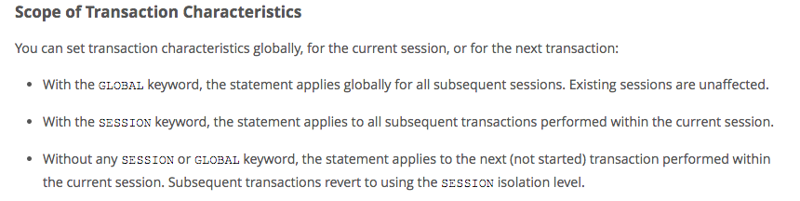
MySQL (Locking) Isolation

Slide 87
Isolation Levels (https://en.wikipedia.org/wiki/Isolation_(database_systems)
Not all transaction use cases require 2PL and serializable execution. Databases support a a set of levels.
Serializable
With a lock-based concurrency control DBMS implementation, serializability requires read and write locks (acquired on selected data) to be released at the end of the transaction. Also range-locks must be acquired when a SELECT query uses a ranged WHERE clause, especially to avoid the phantom reads phenomenon.
The execution of concurrent SQL-transactions at isolation level SERIALIZABLE is guaranteed to be serializable. A serializable execution is defined to be an execution of the operations of concurrently executing SQL-transactions that produces the same effect as some serial execution of those same SQL-transactions. A serial execution is one in which each SQL-transaction executes to completion before the next SQL-transaction begins.
Repeatable reads
In this isolation level, a lock-based concurrency control DBMS implementation keeps read and write locks (acquired on selected data) until the end of the transaction. However, range-locks are not managed, so phantom reads can occur.
Write skew is possible at this isolation level, a phenomenon where two writes are allowed to the same column(s) in a table by two different writers (who have previously read the columns they are updating), resulting in the column having data that is a mix of the two transactions.^{[3][4]}
Read committed
In this isolation level, a lock-based concurrency control DBMS implementation keeps write locks (acquired on selected data) until the end of the transaction, but read locks are released as soon as the SELECT operation is performed (so the non-repeatable reads phenomenon can occur in this isolation level). As in the previous level, range-locks are not managed.
Putting it in simpler words, read committed is an isolation level that guarantees that any data read is committed at the moment it is read. It simply restricts the reader from seeing any intermediate, uncommitted, 'dirty' read. It makes no promise whatsoever that if the transaction re-issues the read, it will find the same data; data is free to change after it is read.
Read uncommitted
This is the lowest isolation level. In this level, dirty reads are allowed, so one transaction may see not-yet-committed changes made by other transactions

Slide 88
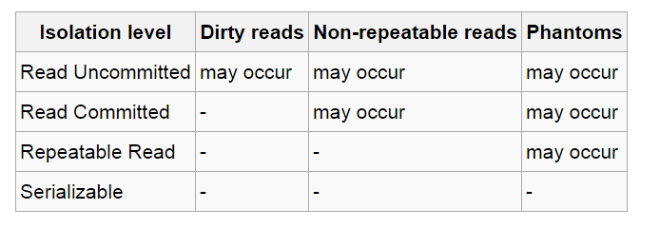
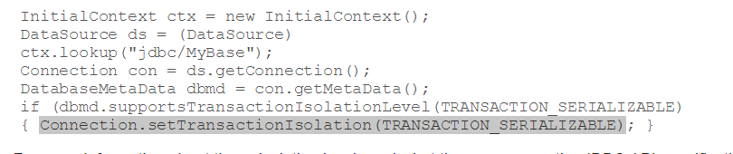
In Databases, Cursors Define Isolation
We have talked about ACID transactions
Atomic: A set of writes all occur or none occur.
Durable: The data “does not disappear,” e.g. write to disk.
Consistent: My applications move the database between consistent states, e.g. the transfer function works correctly.
Isolation
Determines what happens when two or more threads are manipulating the data at the same time.
And is defined relative to where cursors are and what they have touched.
Because the cursor movement determines what you are reading or have read.
But, … Cursors are client conversation state and cannot be used in REST.

Slide 89
Read then Update Conflict
Some
Resource
1. Bob GETs the resource.
3. Bob changes the data based on values.
2. Mary GETs the resource.
If
The written value
Depends on the read value.
The resource may be in the wrong state atthe end.
The execution was RRWW
But the intent was RWRW.
4. Mary changes the data based on values.

Slide 90
Isolation/Concurrency Control
There are two basic approaches to implementing isolation
Locking/Pessimistic, e.g. cursor isolation
Optimistic: Before committing, each transaction verifies that no other transaction has modified the data it has read.
How does this work in REST?
The server maintains an ETag (Entity Tag) for each resource.
Every time a resource’s state changes, the server computes a new ETag.
The server includes the ETag in the header when returning data to the client.
The server may optionally maintain and return “Last Modified” time for resources.
Semantics on updates
If-Match – value of a previous calls ETag response used with a PUT or DELETE. Server should only act if nobody else has modified the resource since you last fetched it. Otherwise provides a 412.
If-Modified-Since – value of a previous Last-Modified response used with a GET. Server should only provide a response if the resource was modified since the timestamp submitted. Use in conjunction with If-None-Match in case the change occurred within the same second. Otherwise provide a 304.
If-None-Match – value of a previous calls ETag response used with a GET. Server should only provide a response if the ETag doesn’t match, i.e. the resource has been altered. Otherwise provide a 304.
If-Unmodified-Since – value of a previous Last-Modified response used with a PUT or DELETE. Server should only act if nobody else has modified the resource since you last fetched it. Otherwise provides a 412

Slide 91
Isolation/Concurrency Control
There are two basic approaches to implementing isolation
Locking/Pessimistic, e.g. cursor isolation
Optimistic: Before committing, each transaction verifies that no other transaction has modified the data it has read.
How does this work in REST?
The server maintains an ETag (Entity Tag) for each resource.
Every time a resource’s state changes, the server computes a new ETag.
The server includes the ETag in the header when returning data to the client.
The server may optionally maintain and return “Last Modified” time for resources.
Semantics on updates
If-Match – value of a previous calls ETag response used with a PUT or DELETE. Server should only act if nobody else has modified the resource since you last fetched it. Otherwise provides a 412.
If-Modified-Since – value of a previous Last-Modified response used with a GET. Server should only provide a response if the resource was modified since the timestamp submitted. Use in conjunction with If-None-Match in case the change occurred within the same second. Otherwise provide a 304.
If-None-Match – value of a previous calls ETag response used with a GET. Server should only provide a response if the ETag doesn’t match, i.e. the resource has been altered. Otherwise provide a 304.
If-Unmodified-Since – value of a previous Last-Modified response used with a PUT or DELETE. Server should only act if nobody else has modified the resource since you last fetched it. Otherwise provides a 412

Slide 92
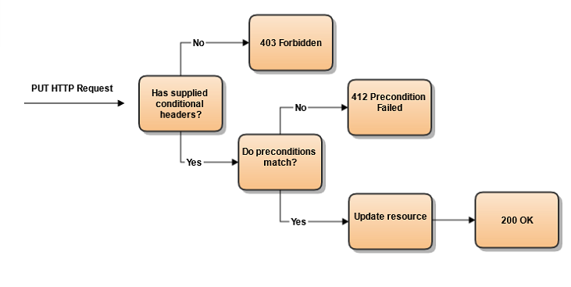
Conditional Processing (https://blog.4psa.com/rest-best-practices-managing-concurrent-updates/)

Slide 93
ETag Processing

Slide 94
Transaction Examples
94 | Introduction to Databases (F18): Lecture 10 Query Processing. Transactions, Recovery

Slide 95
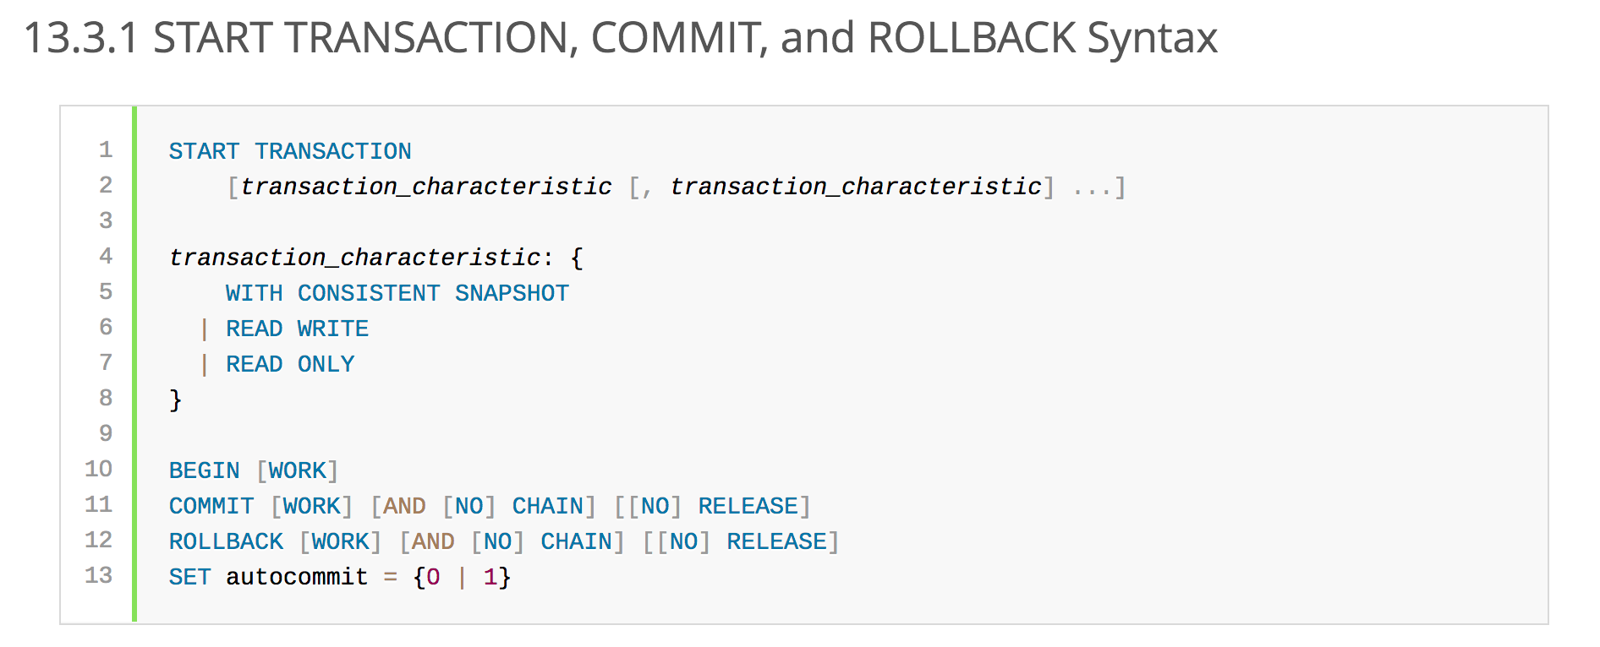
MySQL Transaction Operations

Slide 96



Database

Slide 97


Some Code

Slide 98

Some Code

Slide 99


Create Customer and Account – Failure, No Transaction
Customer INSERT succeeds but account INSERT fails because savings balance insufficient.

Slide 100

Create Customer and Account – Failure
Customer INSERT succeeds but account INSERT fails because savings balance insufficient.
Only one of the two intended inserts happened → Not atomic.

Slide 101


Create Customer and Account – Failure, Transaction
Customer INSERT succeeds but account INSERT fails because savings balance insufficient.
A transaction wraps both inserts.

Slide 102

Create Customer and Account – Failure
Customer INSERT succeeds but account INSERT fails because savings balance insufficient.
Transaction abort/rollback prevents 1st insert from being permanent.
Isolation would prevent other transactions from seeing un-comitted insert.

Slide 103
Comments
In this example, a well designed program would
Catch the exception for the failed account insert.
Explicitly delete the customer record.
To ensure that the transaction moves the DB from one consistent state to another.
But, there are unexpected conditions that a well designed application cannot easily handle:
MySQL fails in between the two inserts.
The client system or client application fails in between the two inserts.
The network connection breaks in between the two inserts.
Another program:
Executes the LEFT JOIN in between the two inserts.
The program would see an inconsistent state.
The “A” and “I” in ACID prevent the unexpected condition from causing an inconsistent database state.

Slide 104
Backup
104 | Introduction to Databases (F18): Lecture 11 Query Processing. Transactions, Recovery

Slide 105

Query Execution Cost

Slide 106
Statistics and Catalogs
Need information about the relations and indexes involved. Catalogs typically contain at least:
# tuples (NTuples) and # pages (NPages) for each relation.
# distinct key values (NKeys) and NPages for each index.
Index height, low/high key values (Low/High) for each tree index.
Catalogs updated periodically.
Updating whenever data changes is too expensive; lots of approximation anyway, so slight inconsistency ok.
More detailed information (e.g., histograms of the values in some field) are sometimes stored.
Notes:
8

Slide 107

MySQL Example

Slide 108
The Catalog Contains
For each table
Table name, storage information.
Attribute name and type for each column.
Index name, type and indexed attributes
Constraints
Statistical information
Cardinality of each table
Size: No. of blocks.
Index cardinality: Number of distinct key values for each index
Index size: Number of blocks for each index.
Index tree height
Index ranges

Slide 109
Access Path
Every relational operator accepts one or more tables as input. The operator “accesses the tuples” in the tables.
There are two “ways” to retrieve the tuples
Scan the relation (via blocks)
Use an index and matching condition.
A selection (WHERE) condition is in conjuctive normal form if
Each term is column_name op value
op is one of <, <=, =, >, >=, <> (or =, != for Hash Index)
The terms are ANDed, e.g. (nameLast = ‘Ferguson’) AND (ab > 500)
CNF allows using a matching index for the access path.
The engine can select a matching index
A Hash Index on (c1,c2,c3) if the condition is c1=x AND c2=y AND c3=z.
A Tree Index if the condition is (can be ordered as)
c1 op value
c1 op x AND/OR c2 op y
… …
Many indexes may match, and the engine chooses the most selective match (number of tuples or blocks) that match.

Slide 110
Access Paths
An access path is a method of retrieving tuples:
File scan, or index that matches a selection (in the query)
A tree index matches (a conjunction of) terms that involve only attributes in a prefix of the search key.
E.g., Tree index on <a, b, c> matches the selection a=5 AND b=3, and a=5 AND b>6, but not b=3.
A hash index matches (a conjunction of) terms that has a term attribute = value for every attribute in the search key of the index.
E.g., Hash index on <a, b, c> matches a=5 AND b=3 AND c=5; but it does not match b=3, or a=5 AND b=3, or a>5 AND b=3 AND c=5.
Notes:
13

Slide 111
Query Rewrite
111 | Introduction to Databases (F18): Lecture 10 Query Processing. Transactions, Recovery

Slide 112

Many Ways to Evaluate a Query

Slide 113
Simple Technique – SELECTion Pushing
Consider two relations
StarsIn(title, year, star_name)
Movies(title, year, length, genre, studio_name, producer_no)
Find everyone who starred in a comedy movie in 1996
Query 1:
SELECT star_name, FROM StarsIn JOIN Movies ON StarsIn.title=Movies.title AND StarsIn.year=Movies.year WHERE StarsIn.year=1996 and Movies.genre=‘Comedy’
Query 2:
SELECT star_name FROM (SELECT star_name, title, year FROM StarsIn WHERE year=1996 as a) JOIN
(SELECT title, year, genre FROM Movies WHERE year=1996 AND genre=‘Comedy’) ON a.year=b.year and a.title=b.title
These queries are equivalent, but (2) is much more efficient.

Slide 114
Simple Technique – SELECTion Pushing
SELECT on a JOIN of table R and table S compares O(#(R)*#(S)) tuples
Have to load relevant blocks
Compare the tuples to compute the JOIN
Scan the JOIN to apply the SELECT
Pushing the SELECT(s) through the JOINs
May vastly reduce the size of the table to JOIN
Only JOIN tuples that could be selected in the WHERE clause.
You can also push project through JOIN, but this reduces the size of the data, not the number of tuples examined.
Consider two relations
StarsIn(title, year, star_name)
Movies(title, year, length, genre, studio_name, producer_no)
Find everyone who starred in a comedy movie in 1996
Query 1:
SELECT star_name, FROM StarsIn JOIN Movies ON StarsIn.title=Movies.title AND StarsIn.year=Movies.year WHERE StarsIn.year=1996 and Movies.genre=‘Comedy’
Query 2:
SELECT star_name FROM (SELECT star_name, title, year FROM StarsIn WHERE year=1996 as a) JOIN
(SELECT title, year, genre FROM Movies WHERE year=1996 AND genre=‘Comedy’) ON a.year=b.year and a.title=b.title
These queries are equivalent, but (2) is much more efficient.

Slide 115
A Note on Complex Selections
(day<8/9/94 AND rname=‘Paul’) OR bid=5 OR sid=3
Selection conditions are first converted to conjunctive normal form (CNF):
(day<8/9/94 OR bid=5 OR sid=3 ) AND (rname=‘Paul’ OR bid=5 OR sid=3)
We only discuss case with no ORs; see text if you are curious about the general case.
Notes:
13

Slide 116
One Approach to Selections
Find the most selective access path, retrieve tuples using it, and apply any remaining terms that don’t match the index:
Most selective access path: An index or file scan that we estimate will require the fewest page I/Os.
Terms that match this index reduce the number of tuples retrieved; other terms are used to discard some retrieved tuples, but do not affect number of tuples/pages fetched.
Consider day<8/9/94 AND bid=5 AND sid=3. A B+ tree index on day can be used; then, bid=5 and sid=3 must be checked for each retrieved tuple. Similarly, a hash index on <bid, sid> could be used; day<8/9/94 must then be checked.
Notes:
14

Slide 117
Using an Index for Selections
Cost depends on #qualifying tuples, and clustering.
Cost of finding qualifying data entries (typically small) plus cost of retrieving records (could be large w/o clustering).
In example, assuming uniform distribution of names, about 10% of tuples qualify (100 pages, 10000 tuples). With a clustered index, cost is little more than 100 I/Os; if unclustered, upto 10000 I/Os!
SELECT *
FROM Reserves R
WHERE R.rname < ‘C%’
Notes:
12

Slide 118
Projection
SELECT DISTINCT
R.sid, R.bid
FROM Reserves R
The expensive part is removing duplicates.
SQL systems don’t remove duplicates unless the keyword DISTINCT is specified in a query.
Sorting Approach: Sort on <sid, bid> and remove duplicates. (Can optimize this by dropping unwanted information while sorting.)
Hashing Approach: Hash on <sid, bid> to create partitions. Load partitions into memory one at a time, build in-memory hash structure, and eliminate duplicates.
If there is an index with both R.sid and R.bid in the search key, may be cheaper to sort data entries!
Notes:
16

Slide 119
Join: Index Nested Loops
foreach tuple r in R do
foreach tuple s in S where r_{i} == s_{j} do
add <r, s> to result
If there is an index on the join column of one relation (say S), can make it the inner and exploit the index.
Cost: M + ( (M*p_{R}) * cost of finding matching S tuples)
M=#pages of R, p_{R}=# R tuples per page
For each R tuple, cost of probing S index is about 1.2 for hash index, 2-4 for B+ tree. Cost of then finding S tuples (assuming Alt. (2) or (3) for data entries) depends on clustering.
Clustered index: 1 I/O (typical), unclustered: upto 1 I/O per matching S tuple.

Slide 120
Join: Sort-Merge (R S)
i=j
Sort R and S on the join column, then scan them to do a ``merge’’ (on join col.), and output result tuples.
Advance scan of R until current R-tuple >= current S tuple, then advance scan of S until current S-tuple >= current R tuple; do this until current R tuple = current S tuple.
At this point, all R tuples with same value in Ri (current R group) and all S tuples with same value in Sj (current S group) match; output <r, s> for all pairs of such tuples.
Then resume scanning R and S.
R is scanned once; each S group is scanned once per matching R tuple. (Multiple scans of an S group are likely to find needed pages in buffer.)
Notes:
11

Slide 121
Example of Sort-Merge Join
Cost: M log M + N log N + (M+N)
The cost of scanning, M+N, could be M*N (very unlikely!)
With 35, 100 or 300 buffer pages, both Reserves and Sailors can be sorted in 2 passes; total join cost: 7500.
Notes:
12

Slide 122
Transactions
Concurrent execution of user programs is essential for good DBMS performance.
Because disk accesses are frequent, and relatively slow, it is important to keep the cpu humming by working on several user programs concurrently.
A user’s program may carry out many operations on the data retrieved from the database, but the DBMS is only concerned about what data is read/written from/to the database.
A transaction is the DBMS’s abstract view of a user program: a sequence of reads and writes.

Slide 123
Concurrency in a DBMS
Users submit transactions, and can think of each transaction as executing by itself.
Concurrency is achieved by the DBMS, which interleaves actions (reads/writes of DB objects) of various transactions.
Each transaction must leave the database in a consistent state if the DB is consistent when the transaction begins.
DBMS will enforce some ICs, depending on the ICs declared in CREATE TABLE statements.
Beyond this, the DBMS does not really understand the semantics of the data. (e.g., it does not understand how the interest on a bank account is computed).
Issues: Effect of interleaving transactions, and crashes.

Slide 124
Atomicity of Transactions
A transaction might commit after completing all its actions, or it could abort (or be aborted by the DBMS) after executing some actions.
A very important property guaranteed by the DBMS for all transactions is that they are atomic. That is, a user can think of a Xact as always executing all its actions in one step, or not executing any actions at all.
DBMS logs all actions so that it can undo the actions of aborted transactions.

Slide 125
Example
Consider two transactions (Xacts):
T1: BEGIN A=A+100, B=B-100 END
T2: BEGIN A=1.06*A, B=1.06*B END
Intuitively, the first transaction is transferring $100 from B’s account to A’s account. The second is crediting both accounts with a 6% interest payment.
There is no guarantee that T1 will execute before T2 or vice-versa, if both are submitted together. However, the net effect must be equivalent to these two transactions running serially in some order.

Slide 126
Example (Contd.)
Consider a possible interleaving (schedule):
T1: A=A+100, B=B-100
T2: A=1.06*A, B=1.06*B
This is OK. But what about:
T1: A=A+100, B=B-100
T2: A=1.06*A, B=1.06*B
The DBMS’s view of the second schedule:
T1: R(A), W(A), R(B), W(B)
T2: R(A), W(A), R(B), W(B)

Slide 127
Scheduling Transactions
Serial schedule: Schedule that does not interleave the actions of different transactions.
Equivalent schedules: For any database state, the effect (on the set of objects in the database) of executing the first schedule is identical to the effect of executing the second schedule.
Serializable schedule: A schedule that is equivalent to some serial execution of the transactions.
(Note: If each transaction preserves consistency, every serializable schedule preserves consistency. )

Slide 128
Anomalies with Interleaved Execution
Reading Uncommitted Data (WR Conflicts, “dirty reads”):
Unrepeatable Reads (RW Conflicts):
T1: R(A), W(A), R(B), W(B), Abort
T2: R(A), W(A), C
T1: R(A), R(A), W(A), C
T2: R(A), W(A), C

Slide 129
Anomalies (Continued)
Overwriting Uncommitted Data (WW Conflicts):
T1: W(A), W(B), C
T2: W(A), W(B), C

Slide 130
Lock-Based Concurrency Control
Strict Two-phase Locking (Strict 2PL) Protocol:
Each Xact must obtain a S (shared) lock on object before reading, and an X (exclusive) lock on object before writing.
All locks held by a transaction are released when the transaction completes
(Non-strict) 2PL Variant: Release locks anytime, but cannot acquire locks after releasing any lock.
If an Xact holds an X lock on an object, no other Xact can get a lock (S or X) on that object.
Strict 2PL allows only serializable schedules.
Additionally, it simplifies transaction aborts
(Non-strict) 2PL also allows only serializable schedules, but involves more complex abort processing

Slide 131
Aborting a Transaction
If a transaction Ti is aborted, all its actions have to be undone. Not only that, if Tj reads an object last written by Ti, Tj must be aborted as well!
Most systems avoid such cascading aborts by releasing a transaction’s locks only at commit time.
If Ti writes an object, Tj can read this only after Ti commits.
In order to undo the actions of an aborted transaction, the DBMS maintains a log in which every write is recorded. This mechanism is also used to recover from system crashes: all active Xacts at the time of the crash are aborted when the system comes back up.

Slide 132
The Log
The following actions are recorded in the log:
Ti writes an object: the old value and the new value.
Log record must go to disk before the changed page!
Ti commits/aborts: a log record indicating this action.
Log records are chained together by Xact id, so it’s easy to undo a specific Xact.
Log is often duplexed and archived on stable storage.
All log related activities (and in fact, all CC related activities such as lock/unlock, dealing with deadlocks etc.) are handled transparently by the DBMS.

Slide 133
Recovering From a Crash
There are 3 phases in the Aries recovery algorithm:
Analysis: Scan the log forward (from the most recent checkpoint) to identify all Xacts that were active, and all dirty pages in the buffer pool at the time of the crash.
Redo: Redoes all updates to dirty pages in the buffer pool, as needed, to ensure that all logged updates are in fact carried out and written to disk.
Undo: The writes of all Xacts that were active at the crash are undone (by restoring the before value of the update, which is in the log record for the update), working backwards in the log. (Some care must be taken to handle the case of a crash occurring during the recovery process!)

Slide 134
Summary
Concurrency control and recovery are among the most important functions provided by a DBMS.
Users need not worry about concurrency.
System automatically inserts lock/unlock requests and schedules actions of different Xacts in such a way as to ensure that the resulting execution is equivalent to executing the Xacts one after the other in some order.
Write-ahead logging (WAL) is used to undo the actions of aborted transactions and to restore the system to a consistent state after a crash.
Consistent state: Only the effects of commited Xacts seen.

